Slide 1
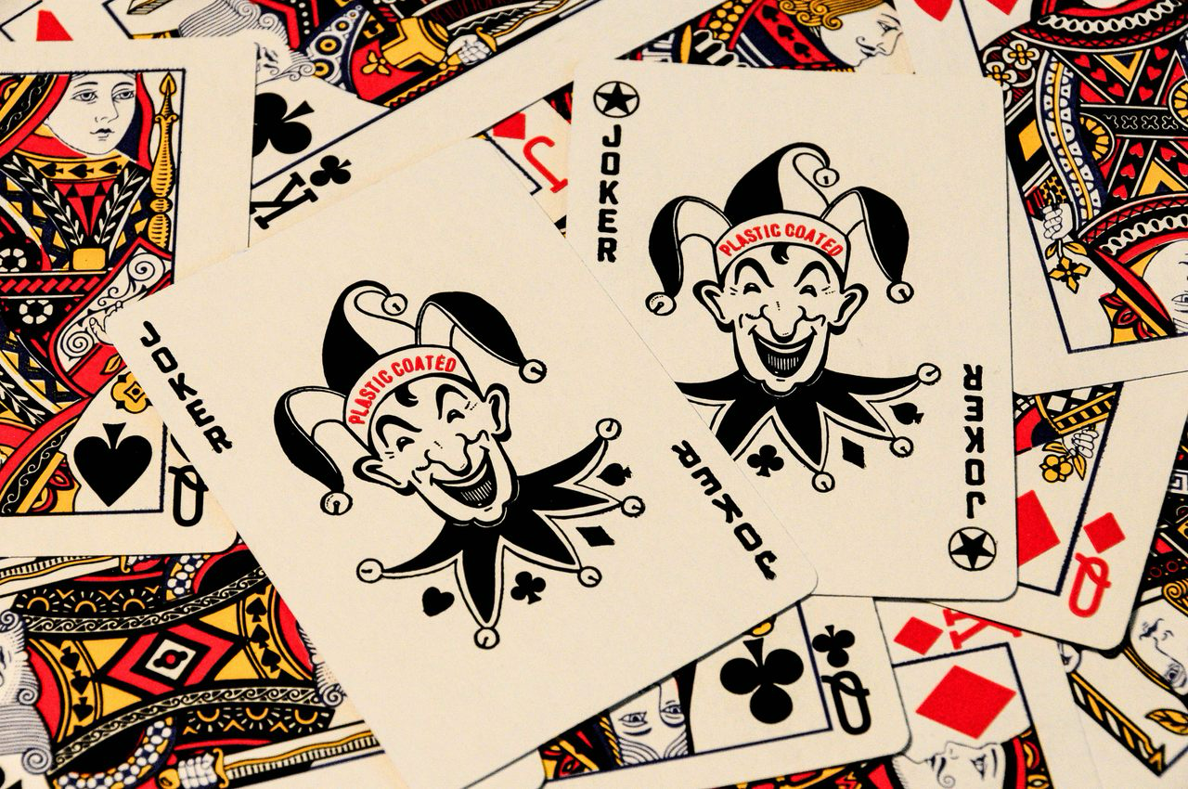
DANIEL, GLORIA, JUAN DIEGO, TRINIDAD
ALGORITHMS FINAL PROJECT
Notes:
TRINI
WHY WE CHOSE IT, WHAT WE PLANNED ON DOING, INITIAL IDEA

Slide 2
AGENDA
GAME RULES
OVERVIEW
CORE ALGORITHMS
CORE DATA STRUCTURES
UI & CLI
Notes:
TRINI

Slide 3
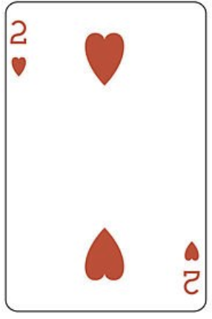
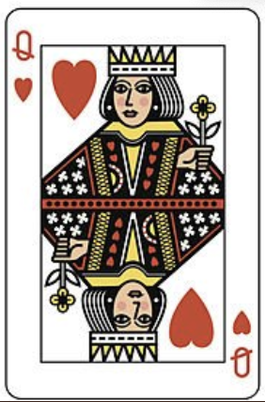
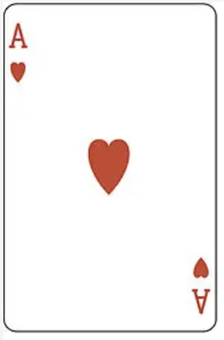
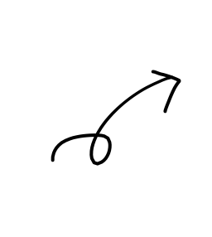
BLACKJACK “21”
Most widely played casino-based card game, 2-7 players.
The key is to beat the dealer…without surpassing 21!
Card Values
** Aces are either worth 1 or 11, depending on its benefits
(with regards to hand)
n
10
1|11
Notes:
GLORIA
Blackjack is also referred to as 21, and its main goal is to beat the dealer. You can beat him by having a hand value closer to 21 than the dealer’s hand, without exceeding 21. As the player, you will be using a classic deck of cards, where each value represents a certain amount of points. You have number cards, which are worth their face value, face cards, each worth 10 points, and aces, which are either 1 or 11, depending on what value benefits the hand more.

Slide 4
RULES
Each player, & Dealer, is given 2 cards
Players take turns deciding whether to hit or stand
Players can continue to hit as many times as they want, but if total value of hand > 21 = round lost
Once all players completed a turn, the dealer reveals the hole card
The dealer must hit until their hand totals += 17 (if the dealer busts, all remaining players win)
If the dealer doesn’t bust, the player's hands are compared to the dealer's. The player with a hand value closer to 21 without going over wins
We simplify the rules for a Dealer VS. Player setup
Notes:
GLORIA
The player and the dealer are given 2 cards. The players then take turns deciding whether to take another card, or to keep their current hand. The player can continue to switch cards as often as they want, but they lose the round as soon as the value of their hands goes over 21. Once all players have completed their turn, the dealer reveals the hole card. The dealer must hit until their hand reaches 17 or higher, but once he loses, the other players automatically win. If not, the player’s hand is compared to the dealer and the value closest to 21 wins.

Slide 5
BLACKJACK VIA CODE
Implementation through multiple functions
CalculateHandValue( )
CalculateHandValueR( )
ShuffleDeck( )
DealCard( )
DealHand( )
main( )
winner( )
ideal_cards( )
probability_of_card( )
DealerAI( )
main_cli( )
❯ : docat *.py | wc -l
688 lines of code
Notes:
DANIEL

Slide 6
BLACKJACK
USERNAME_PROMPT
GAME_RULES
SHUFFLE_DECK
CALC_CARD_VALUE
CALC_HAND_VALUE
DRAWS_CARDS
DISPLAY_INITIAL_HAND
GAME_LOOP
Notes:
TRINI

Slide 7
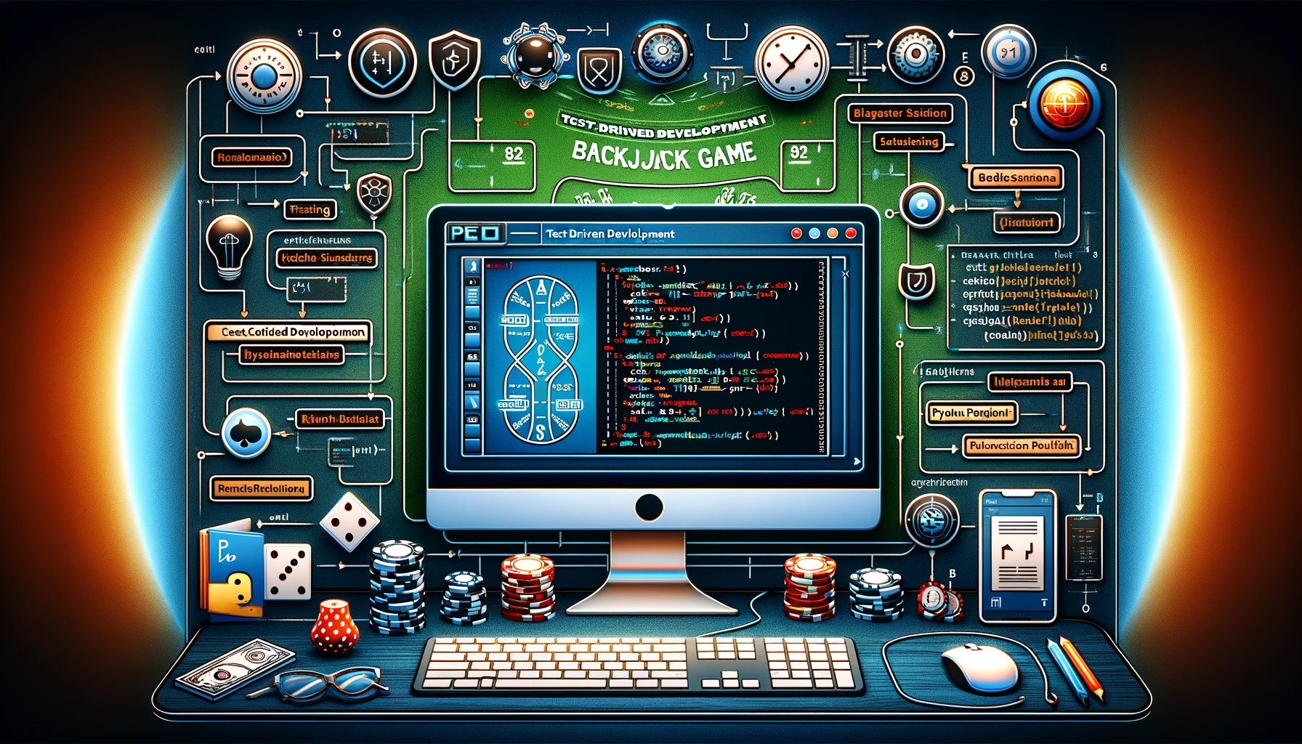
TEST DRIVEN DEVELOPMENT
PEP8 FORMATTING
Notes:
DANIEL

Slide 8
ALGORITHM & DATA
Implementation through multiple algorithms & data structures
ALGORITHMS
Decision Tree: build_tree function
Depth-First Search (DFS): find_good_paths, all_paths_count functions.
Queue: Deck
Fisher-Yates Shuffle: ShuffleDeck function.
Dynamic Programming (Memoization): CalculateHandValue function.
Hash Map (Dictionary): Simplified evaluation
Notes:
TRINI

Slide 9
ALGORITHM OVERVIEW
Name | Worst | Average | Best
Shuffle | O(n) | O(n) | O(n)
Tree (AI) | O(13^DEPTH_LIMIT) | O(13^3) | O(1)
Hand Value | O(n) | O(n) | O(1)
Notes:
DANIEL
REMEMBER TO MENTION WHY WE USED EACH

Slide 10
ShuffleDeck(deck)
Time Complexity of Algorithm: O(n)
the loop iterates through the entire deck
once, and in each iteration, performs constant-time operations
n = number cards in a deck
Best/Worst/Avg: Consistent time complexity of O(n).
Fisher-Yates Algorithm to shuffle the deck:
initializing a variable n with the length of the deck.
enters a loop where (each iteration) it decrements n & randomly selects an index
elements at k, n == n
process continues until all elements in the deck have been iterated over
The function returns a shuffled deck
Fisher-Yates is efficient for randomizing the order of elements in a collection
Notes:
GLORIA
The first main step in our game is to shuffle the deck of cards. The given python function, shuffledeck, implements the fisher yates algorithm to mix the deck of cards, represented as a list. The algorithm starts by initializing a variable n with the length of the deck. It then enters a loop where, in each iteration, it decrements n and randomly selects an index k. It does thi by using the random.randint function. The elements at indices k and n are swapped. The process continues until all elements have been iterated over, resulting in the shuffled deck. The time complexity of this algorithm is O(n), because the loop iterates through the entire deck once, and in each iteration, it performs constant-time operations. The fisher yates shuffle is widely used and is efficient for randomizing the order of elements in a collection.
There are alternatives we couldve implemented, such as the sattolo algorithm, which uses the same principles, but opted not to. Instead of picking an element at random to swap with, like we did in Fisher-Yates, sattolo pick an element at random that is not the element being placed so we do not allow an element to be swapped with itself.
The Sattolo shuffle is a variation of the Fisher-Yates shuffle, but it produces a cyclic permutation rather than a random permutation.
In Sattolo shuffle, the element at each position is swapped with a randomly chosen element that comes after it (excluding itself).
It is often used in situations where a cyclic permutation is desirable, such as in graph algorithms or when creating random cycles.
Fisher-Yates shuffle ensures randomes, so that every possible ordering of the cards is equally likely. This is crucial for fairness in a game like blackjack, where a lack of this could be exploited by players.
It guarantees a uniform distribution of permutations, meaning each possible arrangement of cards has an equal probability of occurring. This is important for a fair shuffle. In contrast, the Sattolo may not provide the same level of randomness.

Slide 11
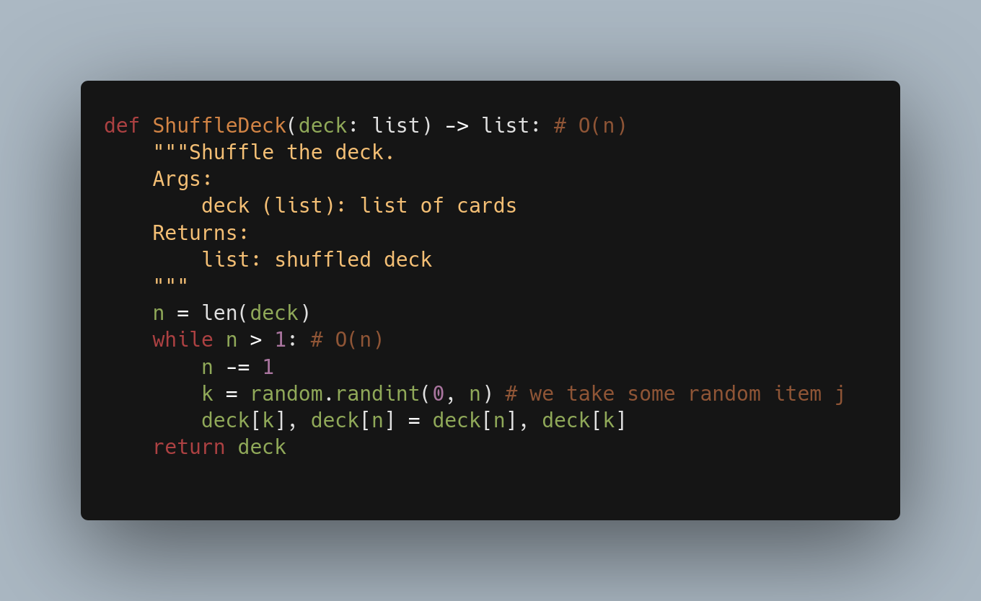
Notes:
GLORIA
in our code, you can see the argument deck which is expected to be a list, , followed by the core of the code, which is the while loop. This loop iterates through the deck in reverse order (n starts at the length of the deck and decreases by 1 in each iteration) and shuffles the elements. Inside the loop, a random index k is generated using random.randint(0, n). This index represents a random card from the remaining unshuffled portion of the deck. The algorithm then swaps the element at index k with the element at the current last index n. the function return the shiffle deck

Slide 12
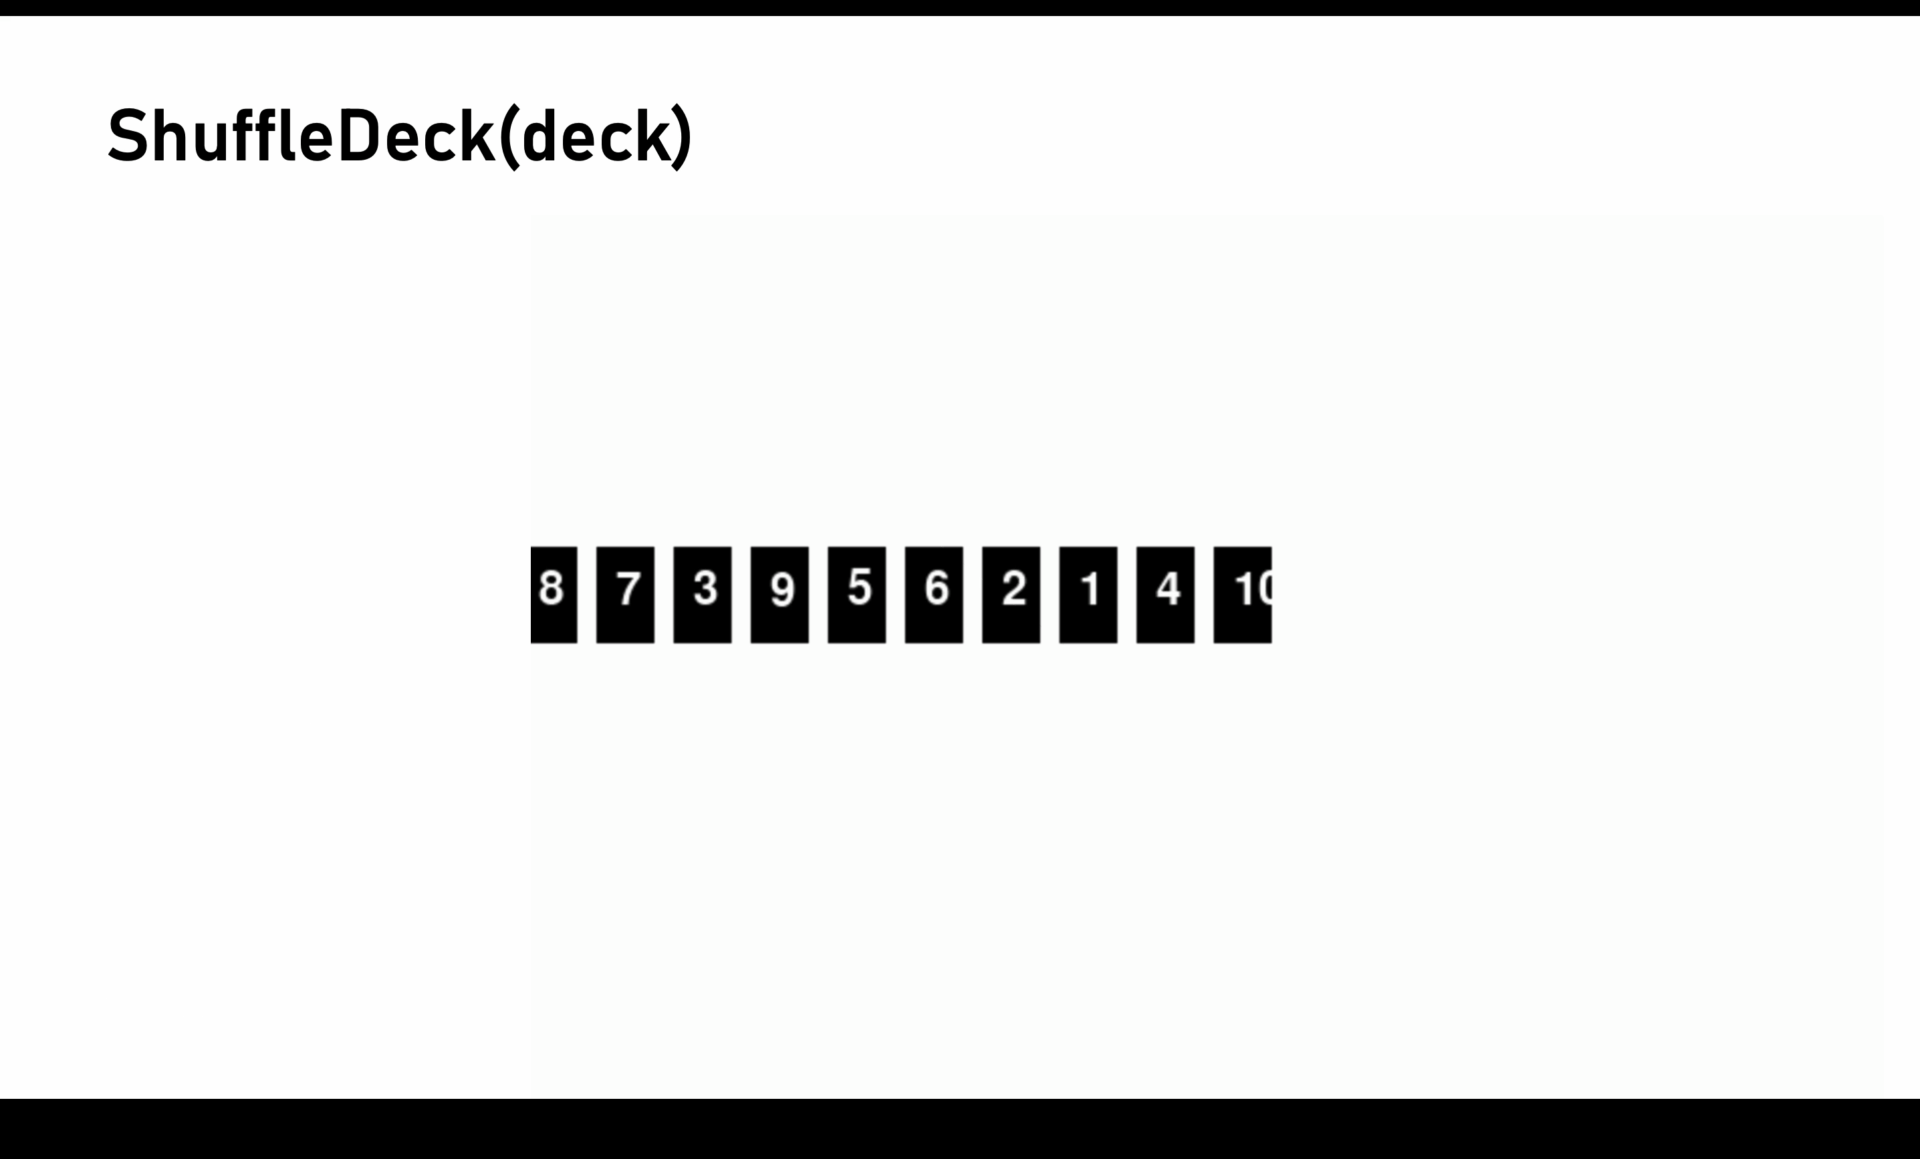
ShuffleDeck(deck)
Notes:
GLORIA
with regards to edge cases, it can be when the deck is empty or has one element. if theinput deck is empty list, the while loop condition (while n > 1) will be False from the beginning, and the function will immediately return the empty deck. This is because the loop requires at least two elements to perform the shuffle, and with an empty deck.
If the input deck has only one element, the while loop will be executed once However, the random index k will always be 0 and the swap operation will essentially be a no-operation. The function will return the deck unchanged.

Slide 13
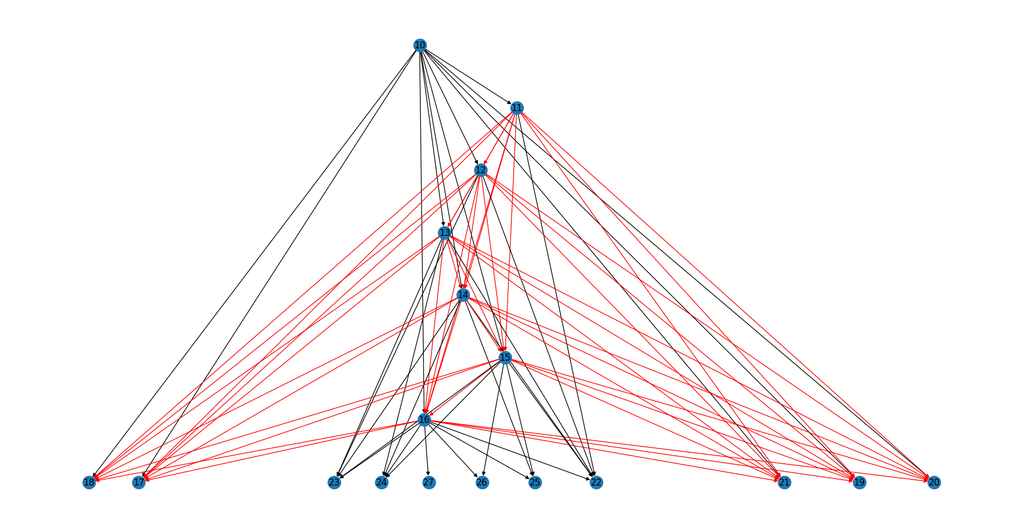
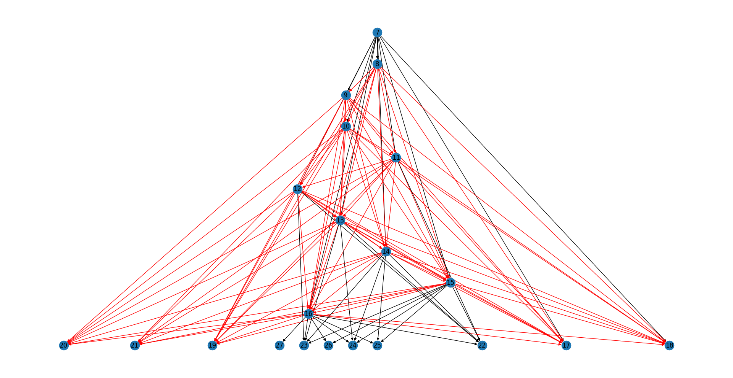
TREE
The potential future states are placed into a tree
→DFS Traversal for optimal paths (those that are victorious)
O(13^n)
Notes:
DANIEL
The tree part in `game_core.py` is used to map out the possible outcomes of the game. It uses a decision tree data structure and a depth-first search algorithm to traverse the tree. Here's a breakdown of how it works:
1. **Data Structures**: The main data structure used is a tree, specifically a decision tree. Each node in the tree represents a possible state of the game. The `Node` class is used to represent a node in the tree. Each `Node` has a `value` (representing the hand value in the game) and a list of `children` (representing the possible next states of the game).
2. **Building the Tree**: The `build_tree` function is used to build the decision tree. It starts with the current hand value as the root of the tree. Then, for each possible card value, it creates a new node (child) with the new hand value (current hand value + card value) and adds it to the current node's children. This process is repeated recursively for each child until the hand value reaches a threshold or exceeds 21.
3. **Traversing the Tree**: The `find_good_paths` function is used to traverse the tree and find all paths that lead to a hand value of 21 or less. It uses a depth-first search algorithm to traverse the tree. It starts at the root and explores as far as possible along each branch before backtracking.
4. **Evaluating the Paths**: The `all_paths_count` function is used to count all possible paths in the tree. The `DealerAI` function then calculates the ratio of "good" paths (paths that lead to a hand value of 21 or less) to all paths. This ratio is used to decide whether the dealer should hit or stand.
5. **Decision Making**: The `DealerAI` function uses the decision tree to decide whether to hit or stand. It calculates the odds of the next card leading to a "good" path and compares it to a threshold to make the decision.
In summary, the tree part in `game_core.py` uses a decision tree data structure and a depth-first search algorithm to map out the possible outcomes of the game and make decisions based on the odds of each outcome.

Slide 14
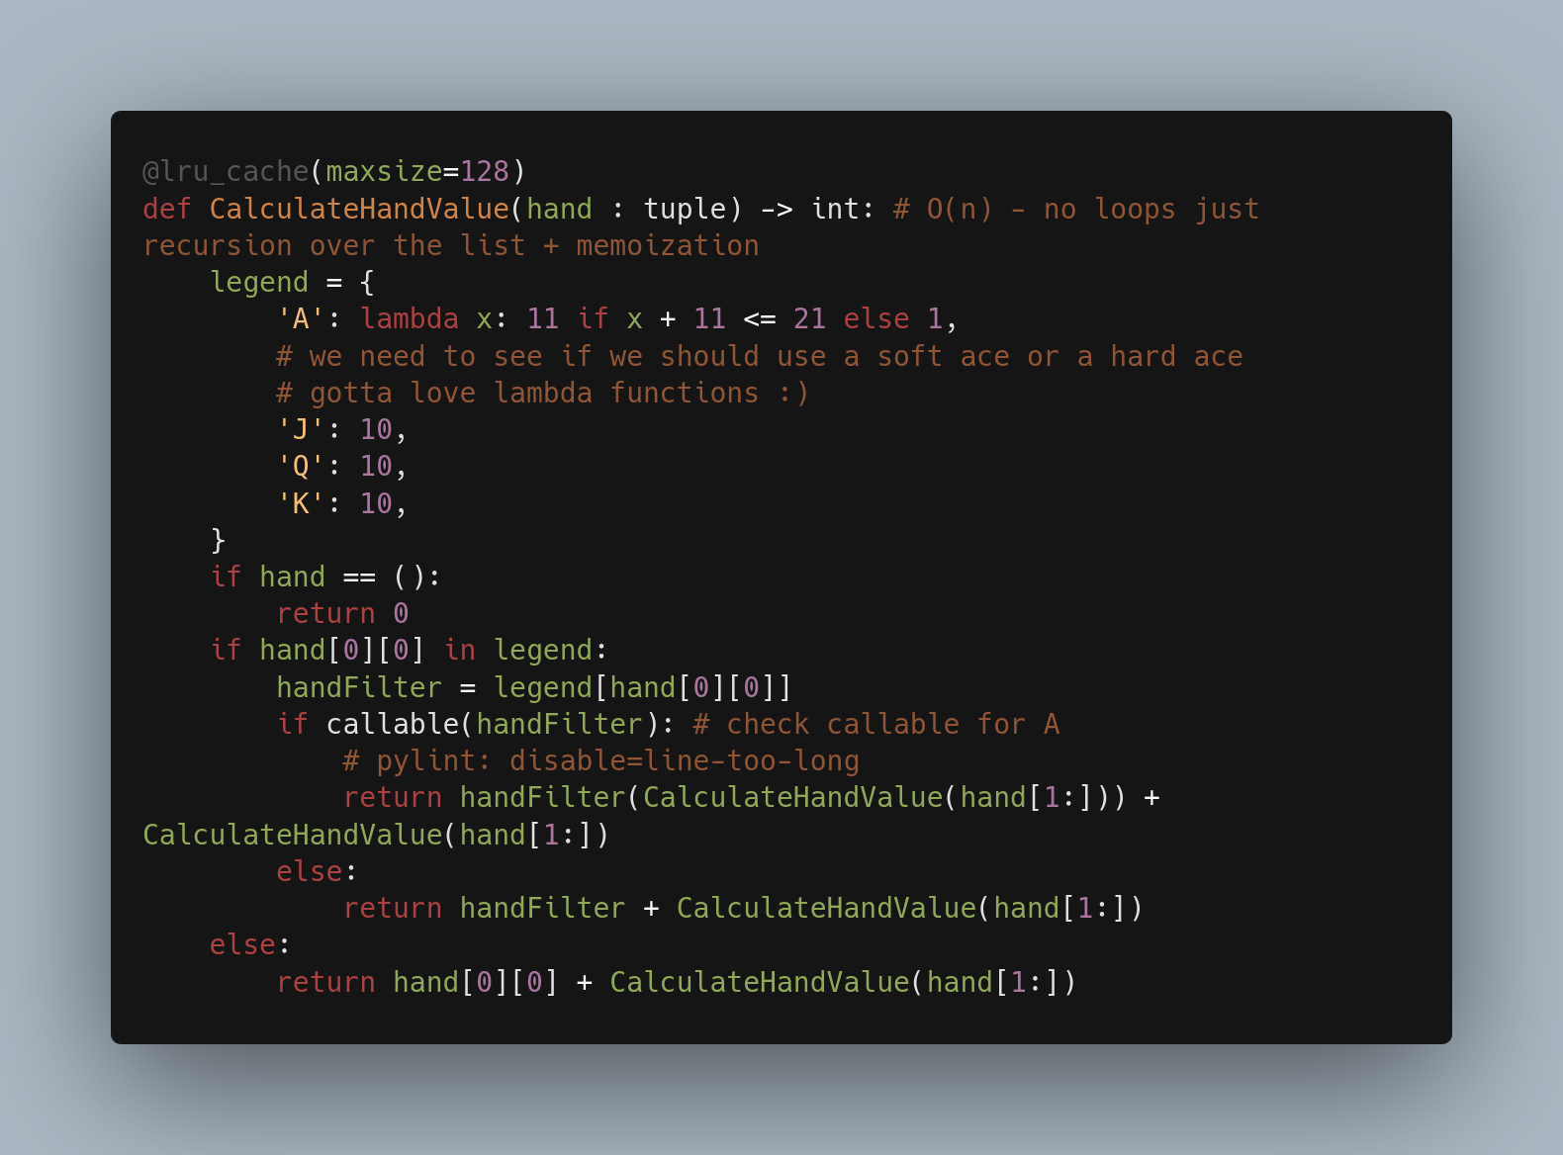
Notes:
D

Slide 15
CalculateHandValue(hand : tuple) -> int:
CalculateHandValue(hand : tuple) -> int: to evaluate hand value
uses memoization (lru_cache) to store previously calculated results & avoid redundancy
dynamic time complexity → depends on amount of subproblems during recursion
memoization ensures each unique sub is solved only once
check if card value is function ('A' for Ace) & applies it
base case handles an empty hand, and the recursion proceeds by calculating the value for the remaining cards in the hand.
Notes:
DANIEL/JUAND
he function utilizes memoization (@lru_cache) to store previously calculated results and avoid redundant computations.
The time complexity is dynamic, as it depends on the number of unique subproblems encountered during the recursive calls. The memoization ensures that each unique subproblem is solved only once.
The function checks if the card value is a function (e.g., 'A' for Ace) and applies it accordingly, considering the possibility of both a soft and hard Ace.
The base case handles an empty hand, and the recursion proceeds by calculating the value for the remaining cards in the hand.

Slide 16
DATA STRUCTURE OVERVIEW
Dictionary
Map symbols to corresponding card names
Convenient way to associate values
Tuple
Each card is a tuple (suit, value)
Immutable and ordered
List
Extensively used for decks, hands, and other collections
Sets
Track seen cards
constant-time membership testing
Efficient to check if card has been seen before
Notes:
JUANDI
Dictionary:
In the game, we've used dictionaries to map symbols to corresponding card names since dictionaries provide a convenient way to associate values. In our case, the symbols 'S', 'H', 'D', and 'C' are mapped to their respective card suits ('Spades', 'Hearts', 'Diamonds', 'Clubs'). This mapping simplifies the process of displaying card information, making the code more readable and maintainable.
Tuple:
Each card is represented as a tuple containing two elements: the card's suit and value. They are the best choice since Tuples are immutable and ordered. This immutability ensures that once a card is created, its values cannot be changed, providing data integrity. The ordered nature of tuples helps maintain the sequence of cards in the deck, contributing to the logic of the game.
List:
Lists are extensively used for representing decks, hands, and other collections of cards. They are versatile and offer easy indexing, iteration, and modification of elements. In our game, they serve as dynamic containers for managing cards, allowing us to shuffle decks, deal hands, and manipulate collections efficiently.
Sets:
Sets provide constant-time membership testing. This efficiency is valuable for checking whether a card has been seen before. By using sets, we ensure that the same card is not dealt more than once, contributing to the fairness and integrity of the game.

Slide 17
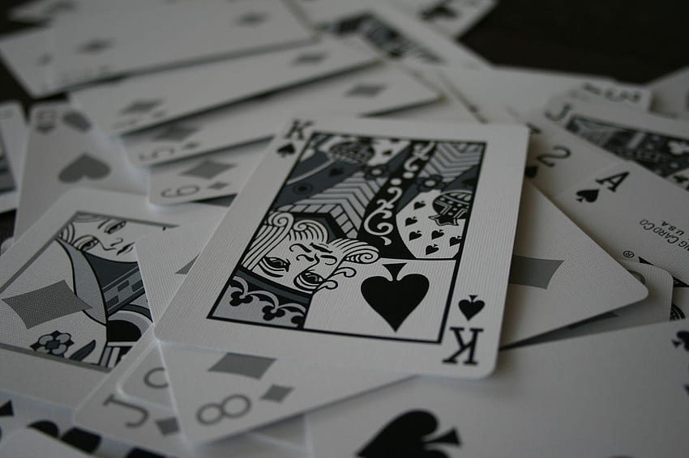
CHALLENGES & SOLUTIONS
Seeing how to create the CPU player,
(especially when it comes to the probabilities)
Circular imports
Building the tree of possible states of the game
Notes:
JUANDI
We went through various iterations that sometimes looked like they worked sometimes not. Finally figured out an approach that takes into account the odds of hitting a card with a value that will not bust the dealer.
, when we modularized the files into different files, some imports needed to go both ways, in the end we fixed by moving around certain methods
, it was difficult to find a way to best represent the game. In the end we just took the possible states the entire game could go through based on the possible hits we could do, this made a very large tree, we could then prune by limiting the depth manually, and also adding a (safe hit) option which will always hit at a certain level at which we are certain we won't bust.

Slide 18
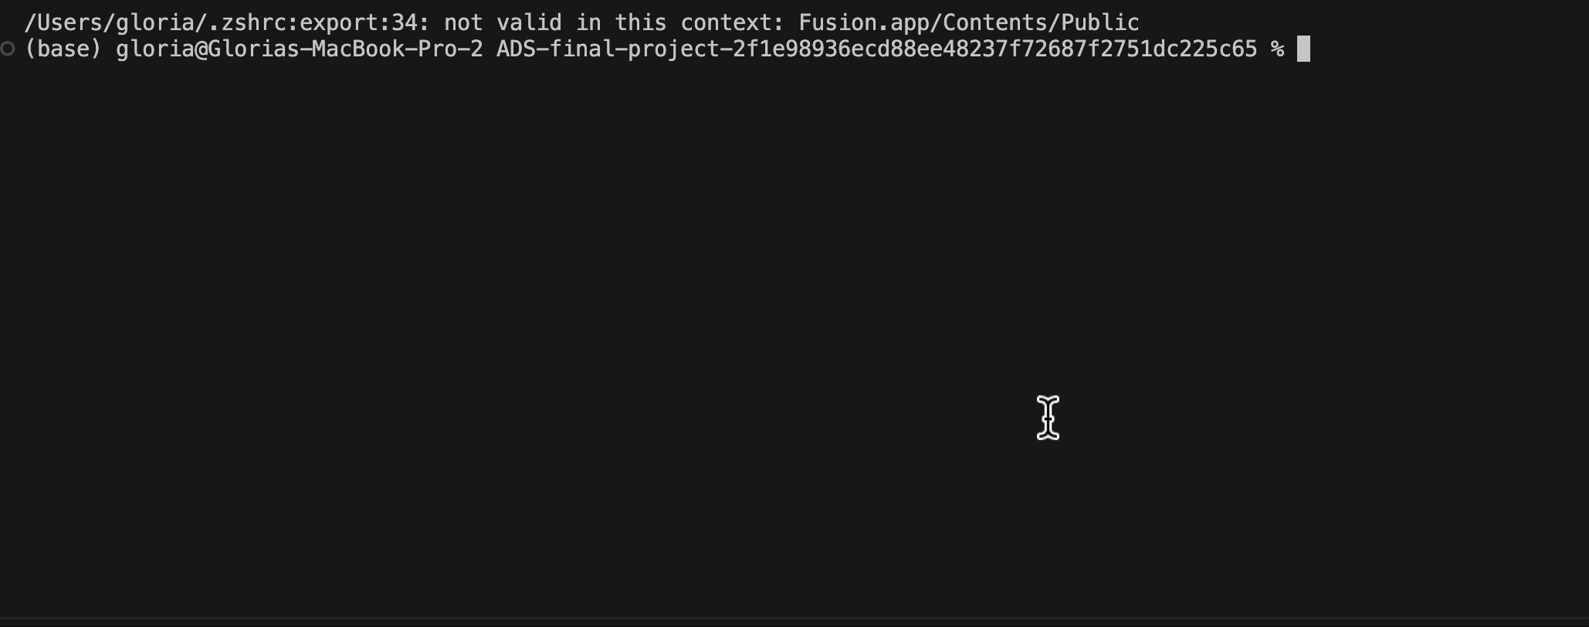
VISUAL
Notes:
JUANDI

Slide 19
DANIEL, GLORIA, JUAN DIEGO, TRINI
ALGORITHMS FINAL PROJECT
Notes:
TRINI

